Slide 1

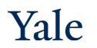
Deep Learning Theory and Applications Learning, Memorization and Generalization
CPSC/AMTH 663

Slide 2
Outline
Classic Generalization Bound
Effective Capacity
Overparameterization
Double Descent Curve
Memorization vs Interpolation
Smoothness
Norm-based regularization
Implicit SGD regularization
Coherent Gradients

Slide 3
Generalization
Underfit: training error high, test error high
Good fit: training error low, test error low
Overfit: training error low, test error high
Generalization is the ability for a model to perform well on test data, i.e. generalize its results from training to test
Thus classically people have linked generalization to model capacity
Ex: regularizations motivated as ability to reduce model capacity and therefore increase generalizations

Slide 4
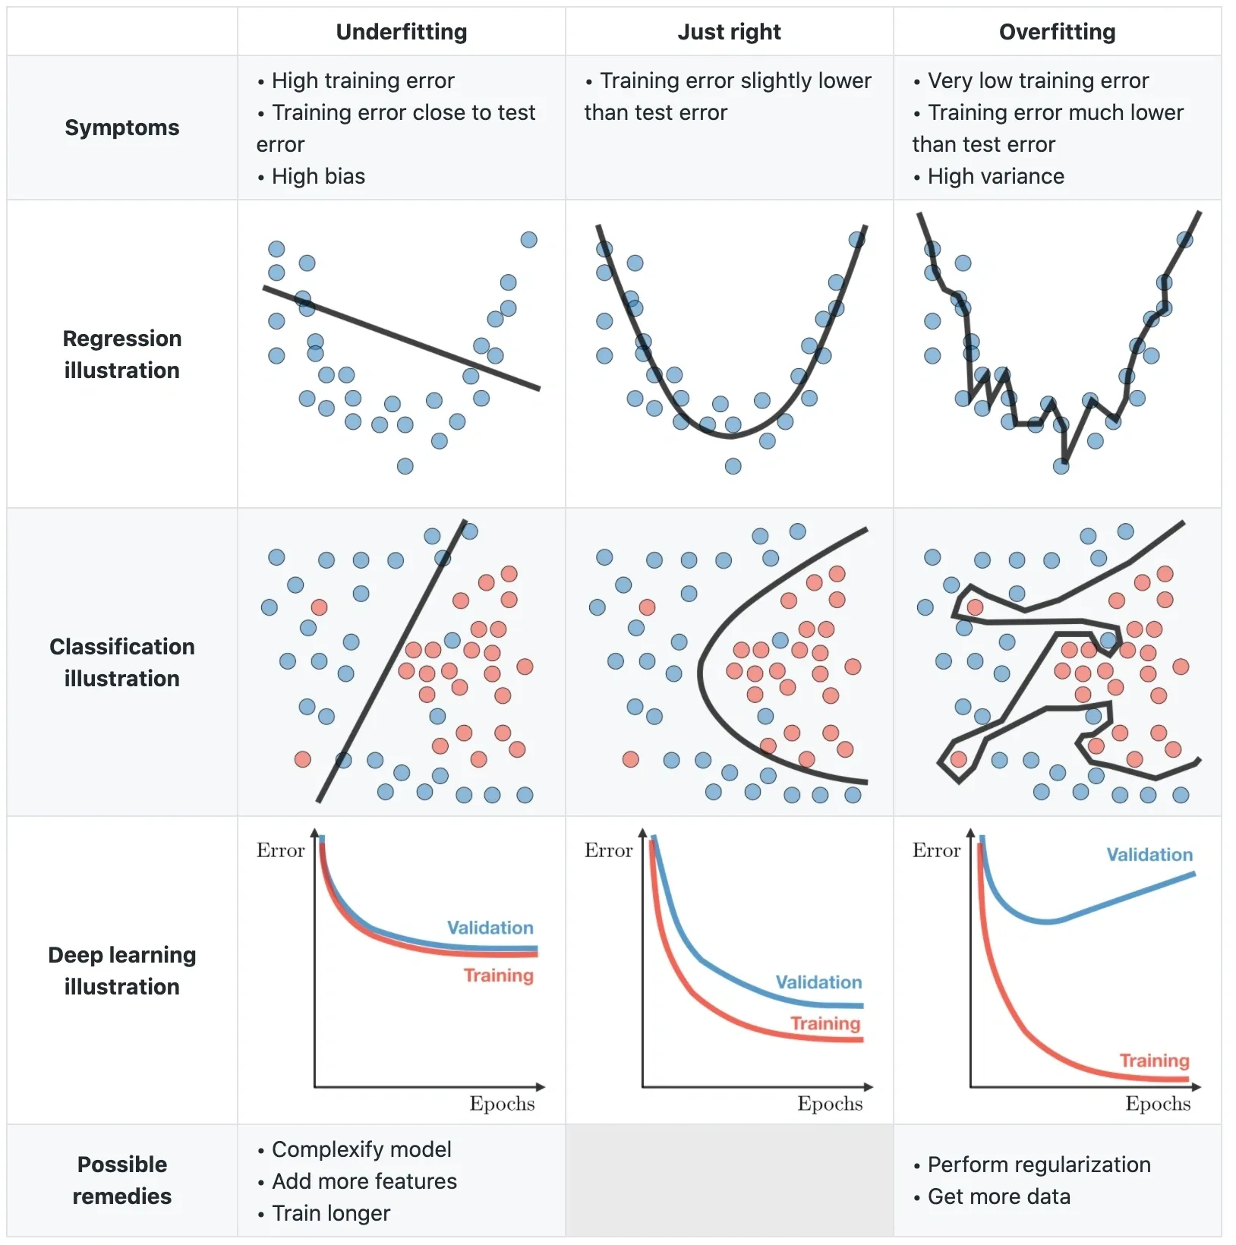
Classic notion of over/underfit
Connects generalization of a fit to model capacity

Slide 5
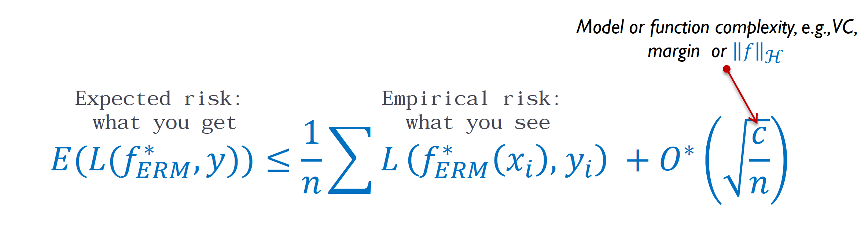
Classic optimization

Slide 6
Effective capacity
The effective capacity of neural networks is sufficient to “memorize” the entire dataset
Deep networks do fine at reducing training error on random samples
Reshuffled labels
Random images
They form a model that is “over-parameterized”, i.e. the number of parameters approaches the size of the data
Yet they generalize!
[Zhang et al ICLR 2017]

Slide 7
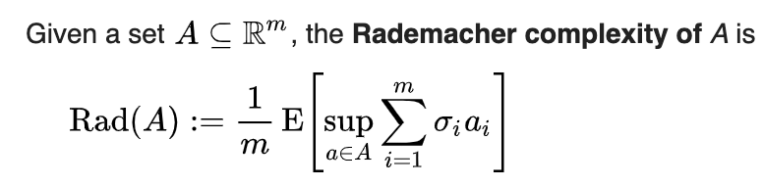

Rademacher complexity
Rademacher complexity refers to the ability to fit random functions

Slide 8
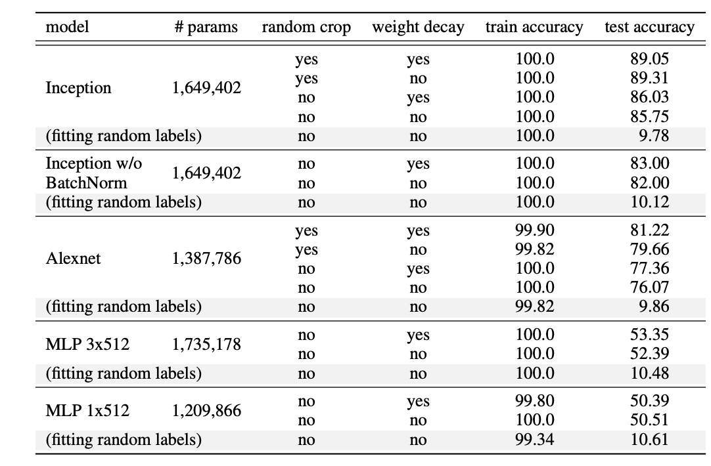
Random noise is fit with or without regularization !
[Zhang et al 2017]

Slide 9
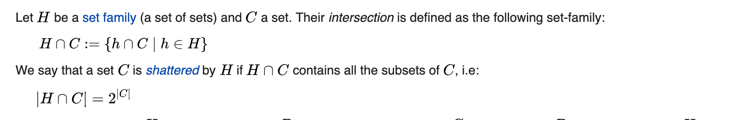
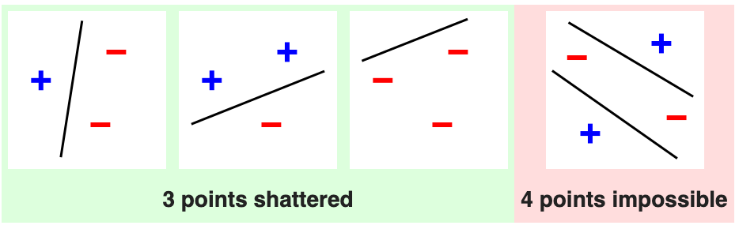
VC Dimension

Slide 10
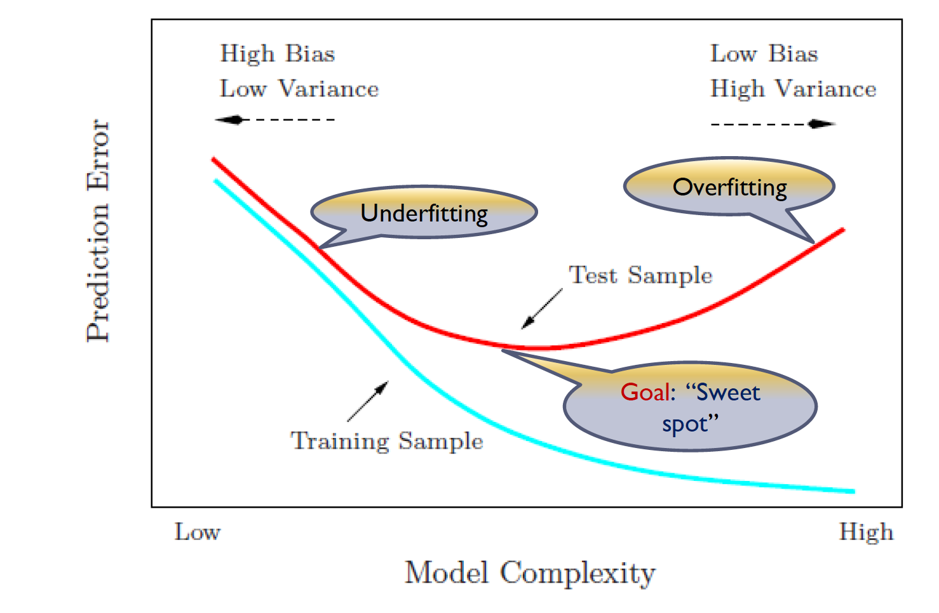
Classic U Curve
Zero training error does not generalize according to this model, it is overfit

Slide 11
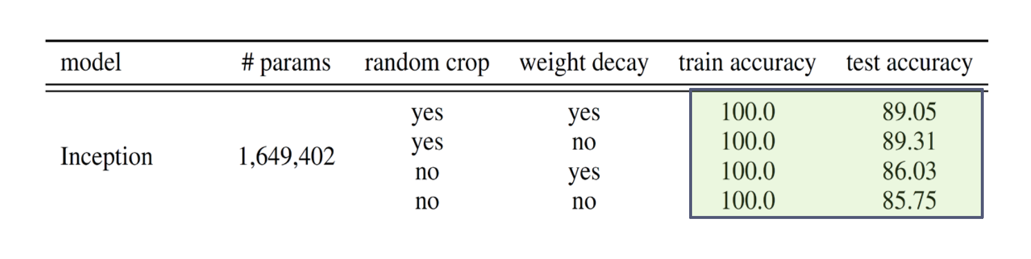
Neural Network Behavior
Zhang et al. 2017

Slide 12
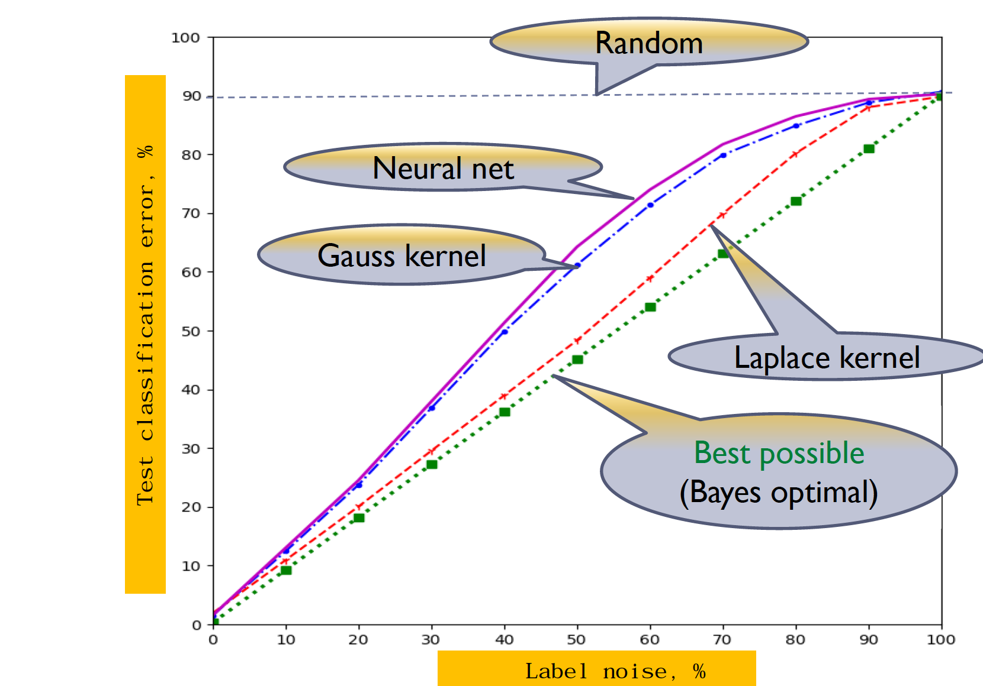
Overparameterization does not overfit noisy data

Slide 13
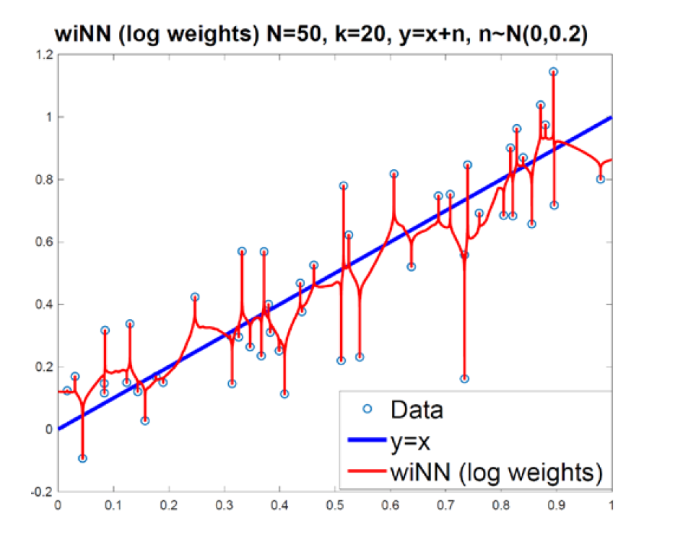
1 Nearest Neighbor KNN Classifier

Slide 14
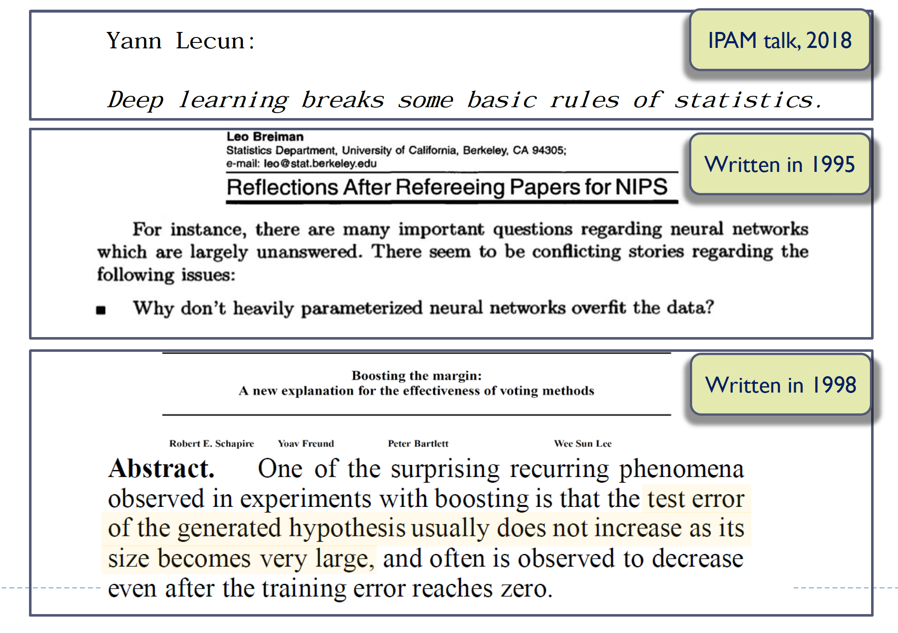

Slide 15
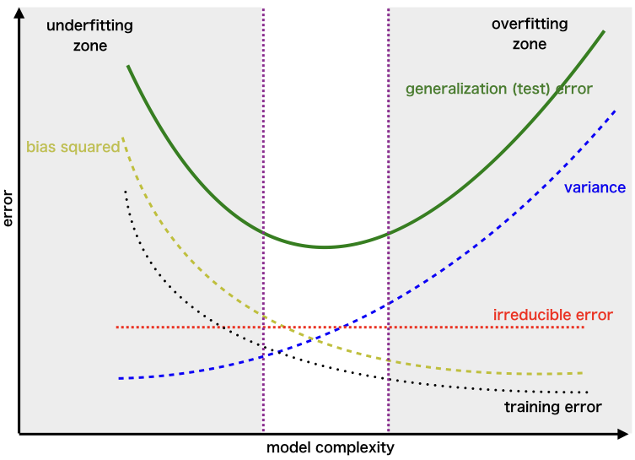
bias-variance trade-off

Slide 16
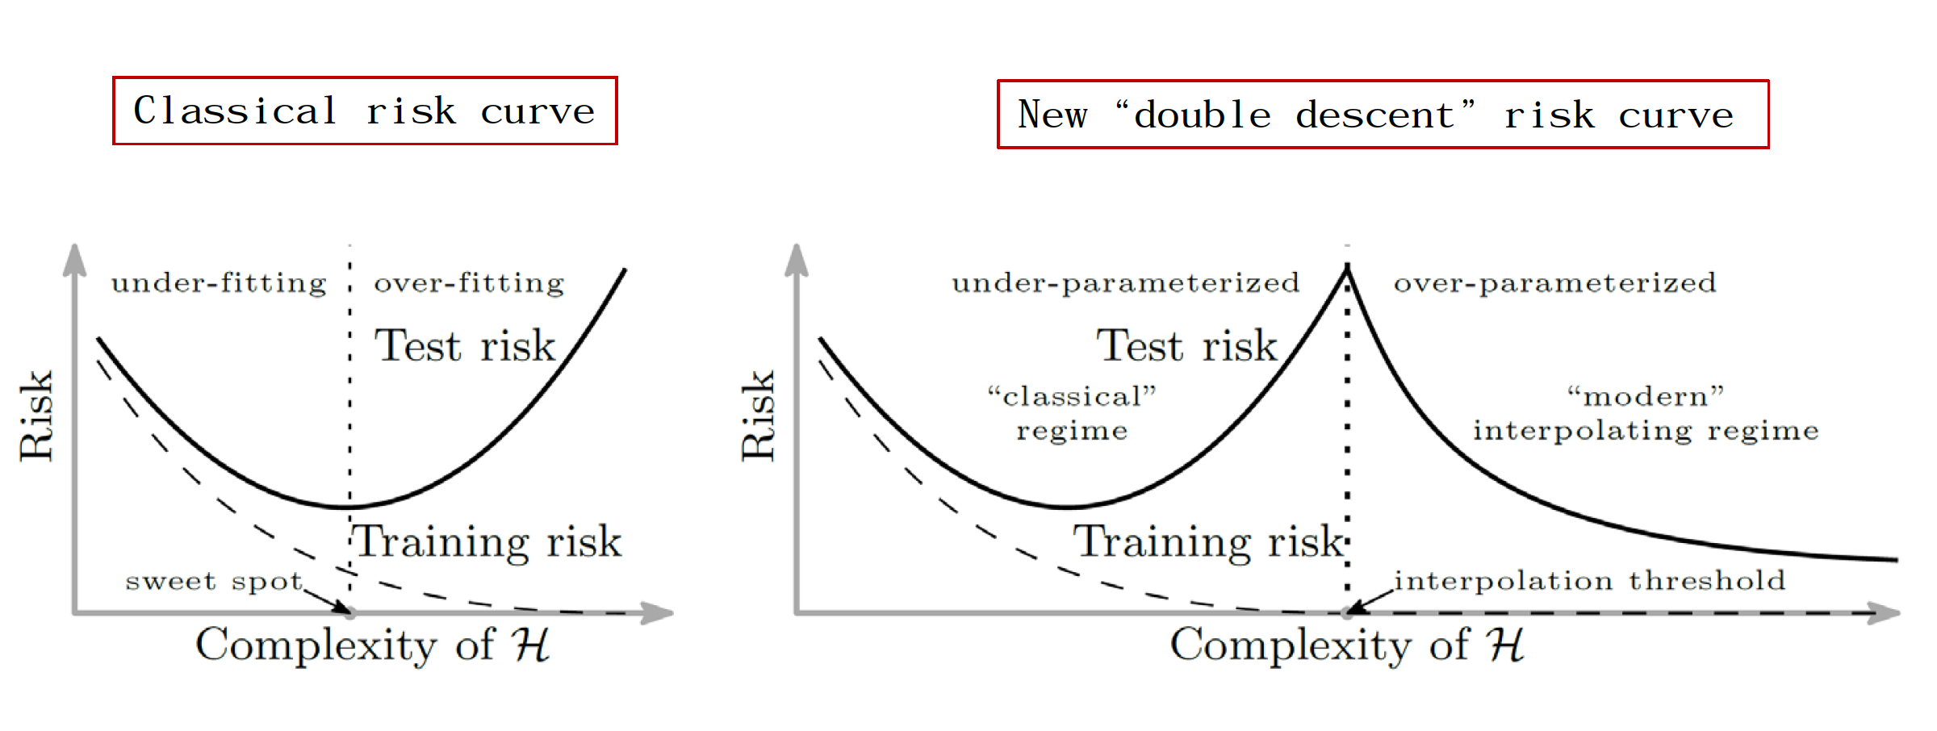
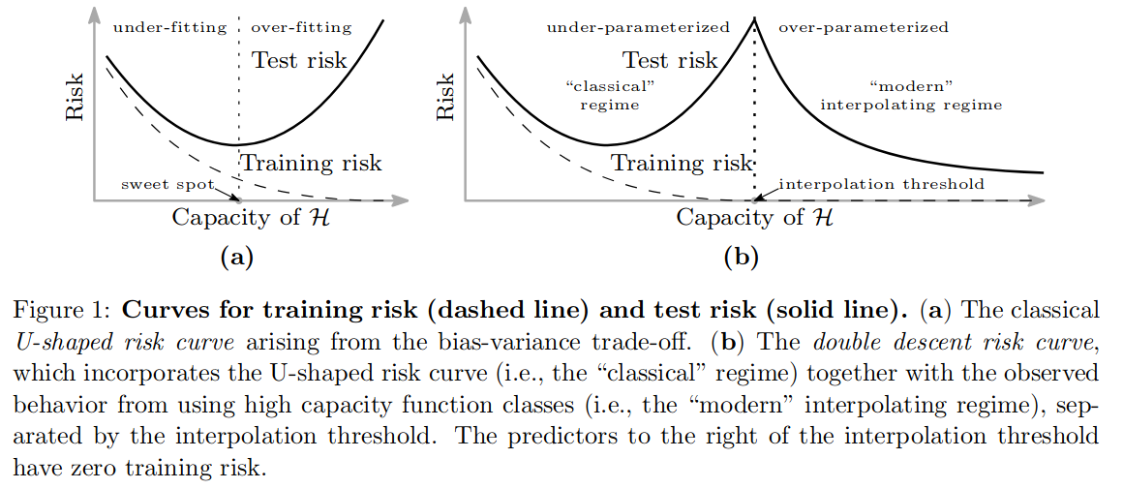
Hsu et al. PNAS 2019

Slide 17
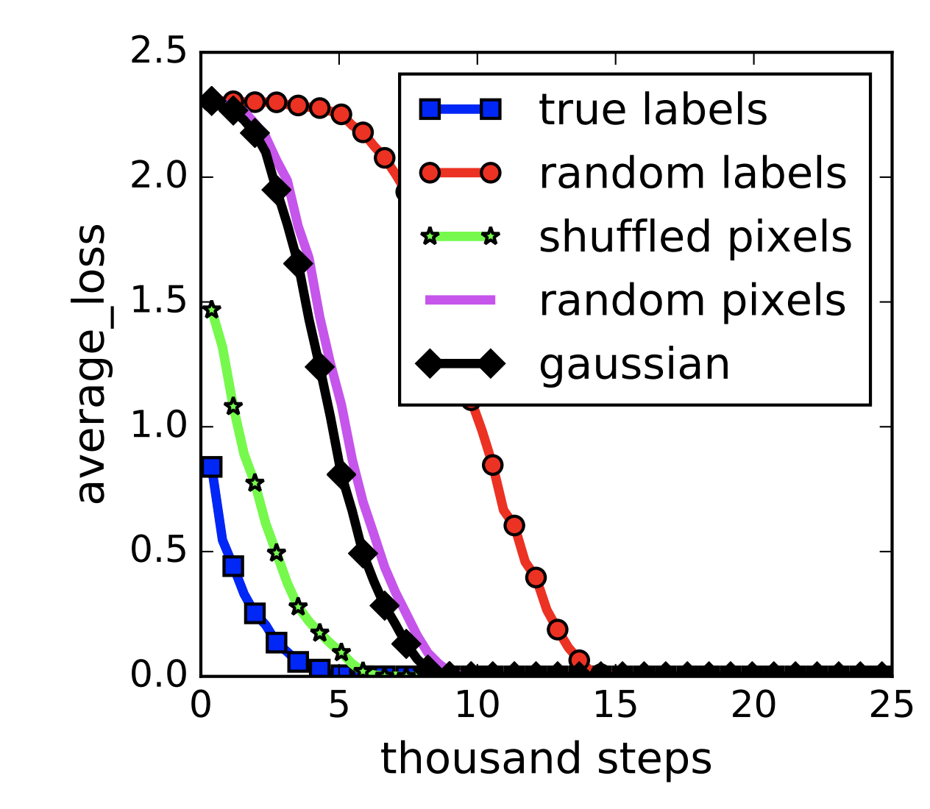
Memorization = fitting to random data
[Zhang et al. ICLR 2017]

Slide 18
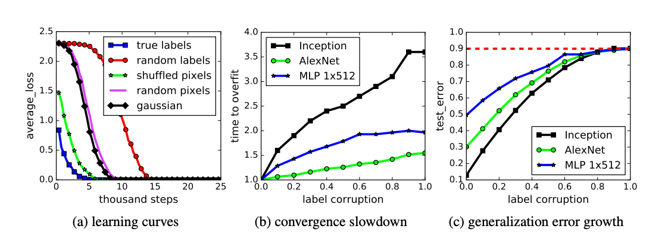
Memorization does not generalize

Slide 19
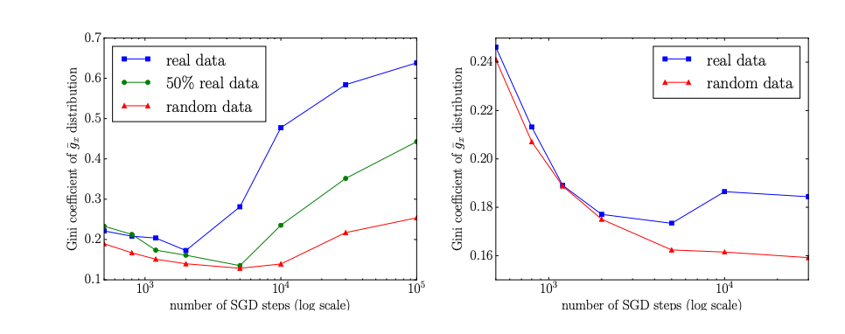
What exactly are neural networks doing that’s different?
[Arpit et al 2017]
Loss gradient with each input looks different, i.e., the impact that an input has on
future loss looks very different

Slide 20
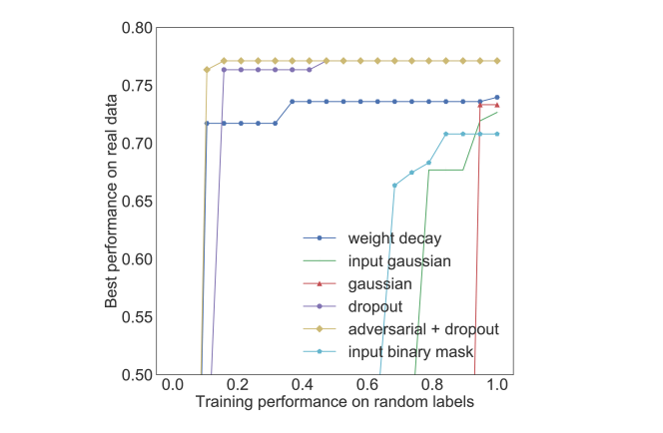
What are regularizations doing?
[Arpit et al. 2017[
They affect the ability to generalize but not on the ability model capacity

Slide 21
Rethinking Generalization
Why do models generalize?
When do they generalize vs memorize?
What does regularization do---because it doesn’t really restrict capacity?

Slide 22
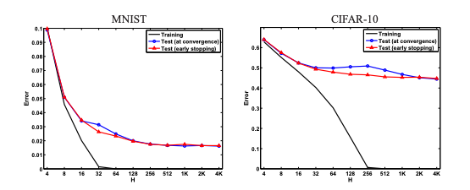
Inductive bias
[ Neyshabur et al 2015]
An inductive bias that induces some sort of capacity control (i.e. restricts or encourages predictors to be “simple” in some way), which in turn allows for generalization
The success of learning then depends on how well the inductive bias captures reality
The inductive bias is not the size of the neural network, what could it be?

Slide 23
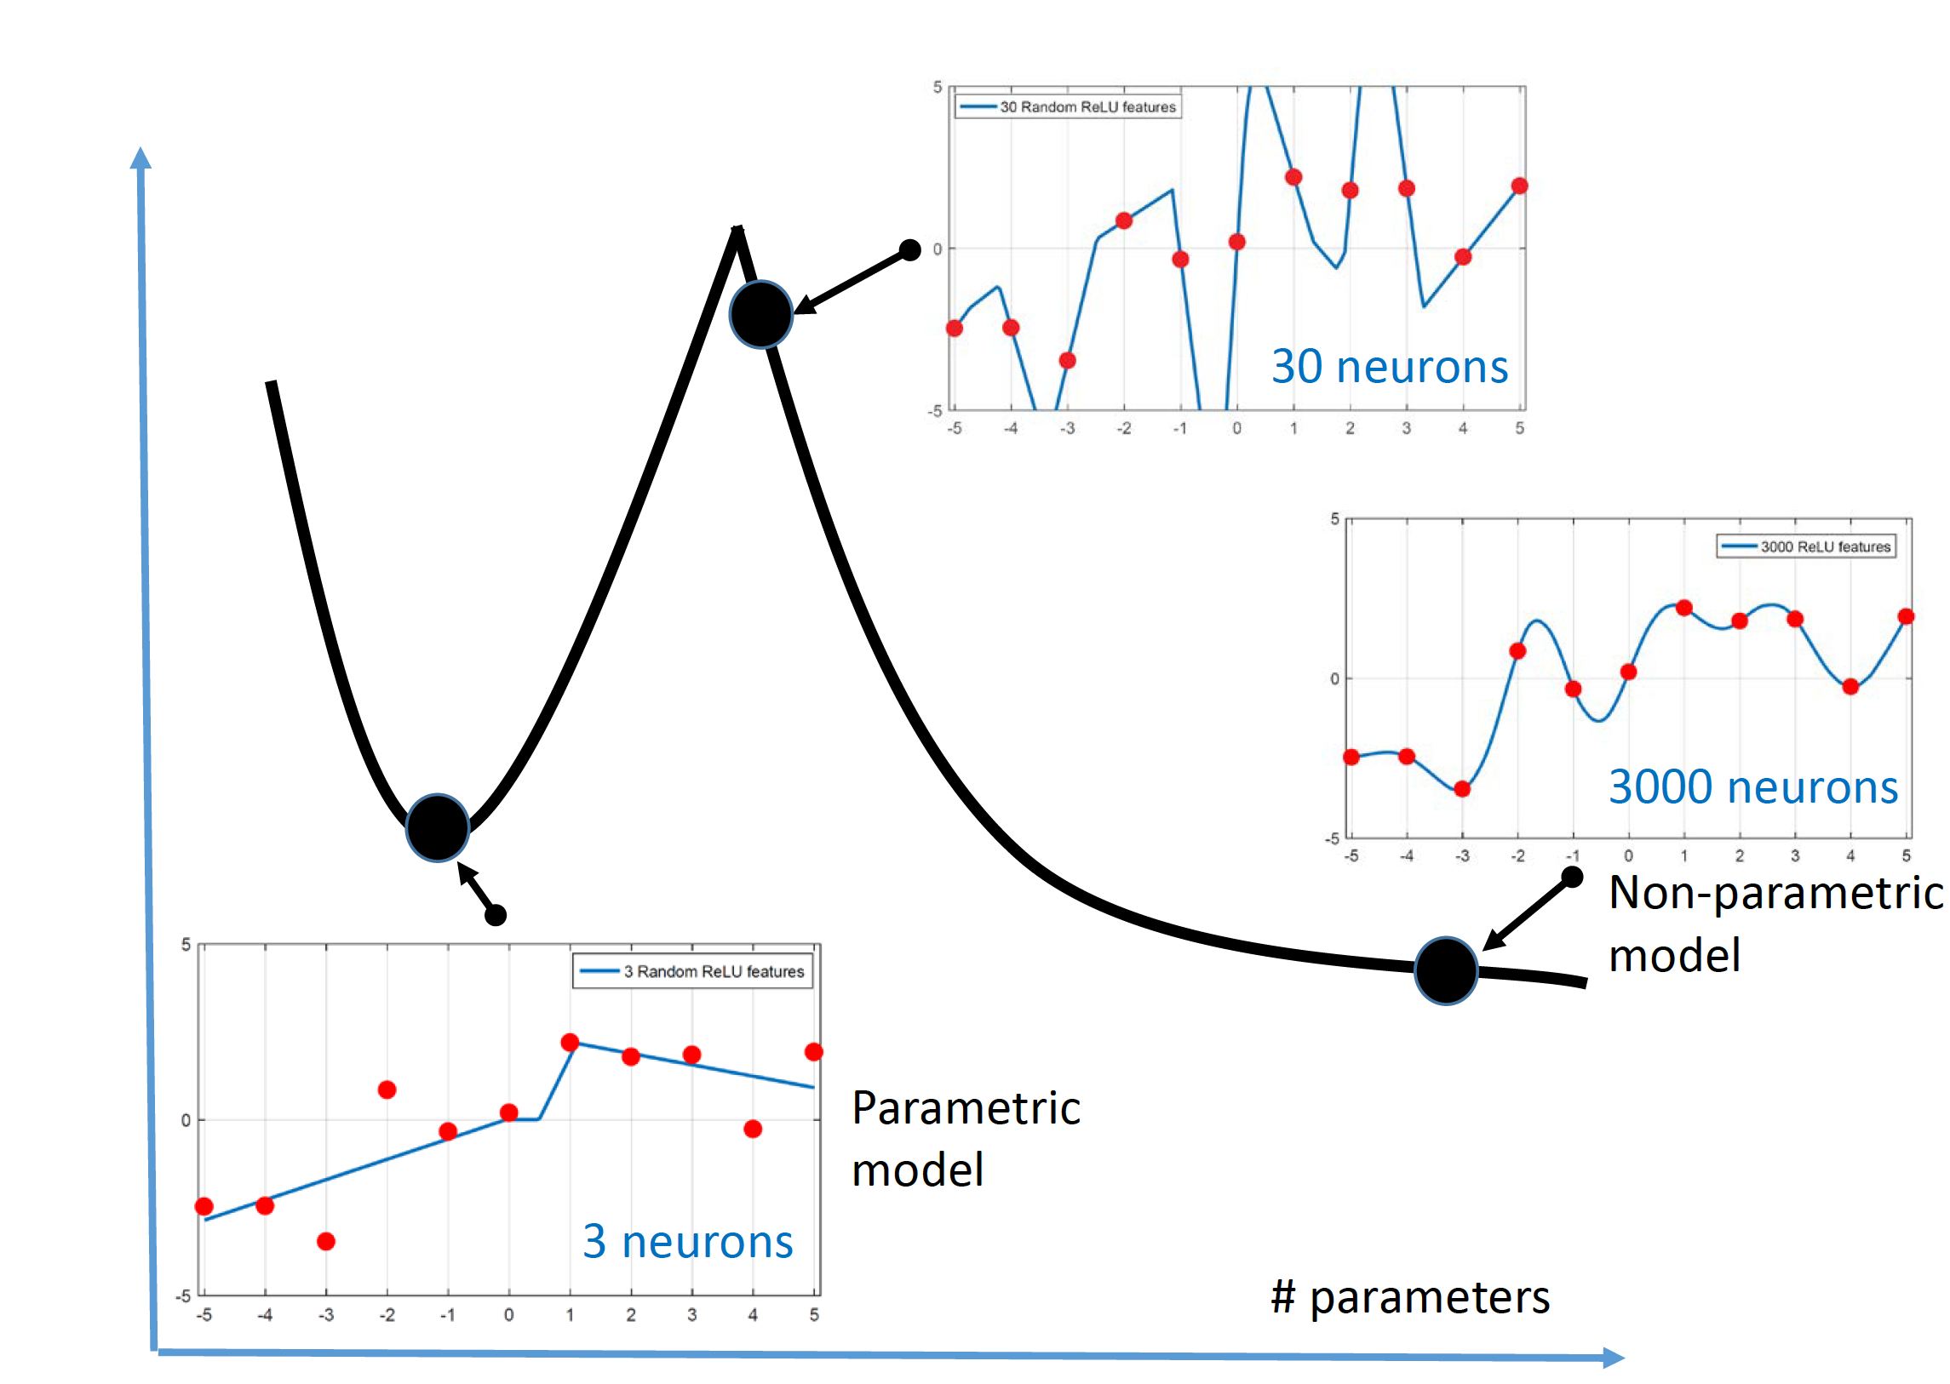
RelU networks
Puzzle: why does increasing parameters by a little bit overfit, but a lot does not?

Slide 24
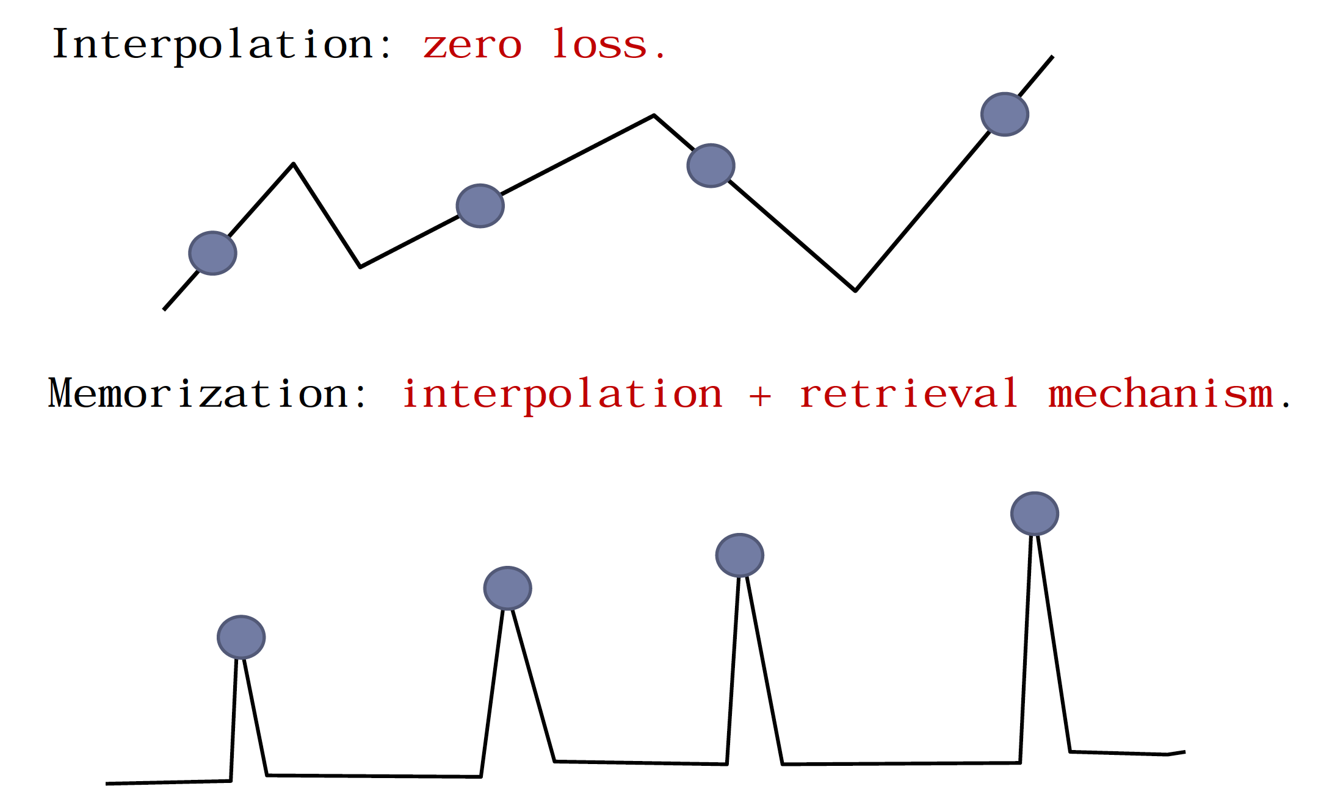
Memorization vs Interpolation
Difference between memorization and interpolation has to do with smoothness

Slide 25
N-->infinity
Choosing the smoothest function that perfectly fits observed data is a form of Occam’s razor: The simplest explanation compatible with the observations should be preferred
Larger function classes (with more parameters) contain more candidate predictors compatible with the data
=> We can find interpolating functions that have smaller norm and are thus “simpler.”
I.e., increasing function class capacity improves performance of classifiers.

Slide 26
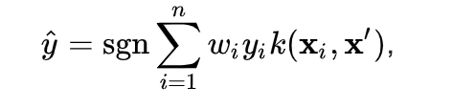
Kernel Methods
Kernel methods memorize a label for a training instance (x_{i}, y_{i}) and extend beyond training data to test data x’ using a similarity function k(x, x’)
The Kernel trick is that this kernel function can be shown to be an inner product in a higher dimensional space as long as the similarity matrix is positive semi-definite (Mercer’s Theorem)

Slide 27
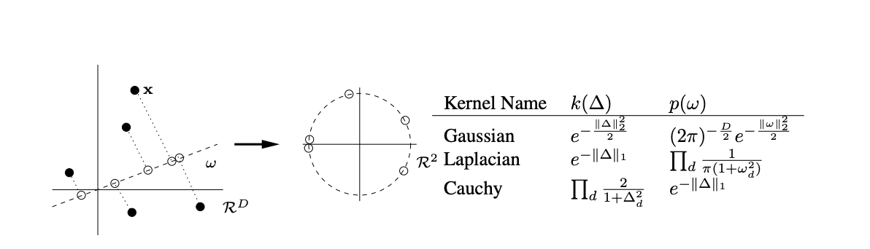
Random Fourier Features
Instead of using a similarity function kernel use a random projection into a different space and use inner products there to approximate kernels quickly

Slide 28
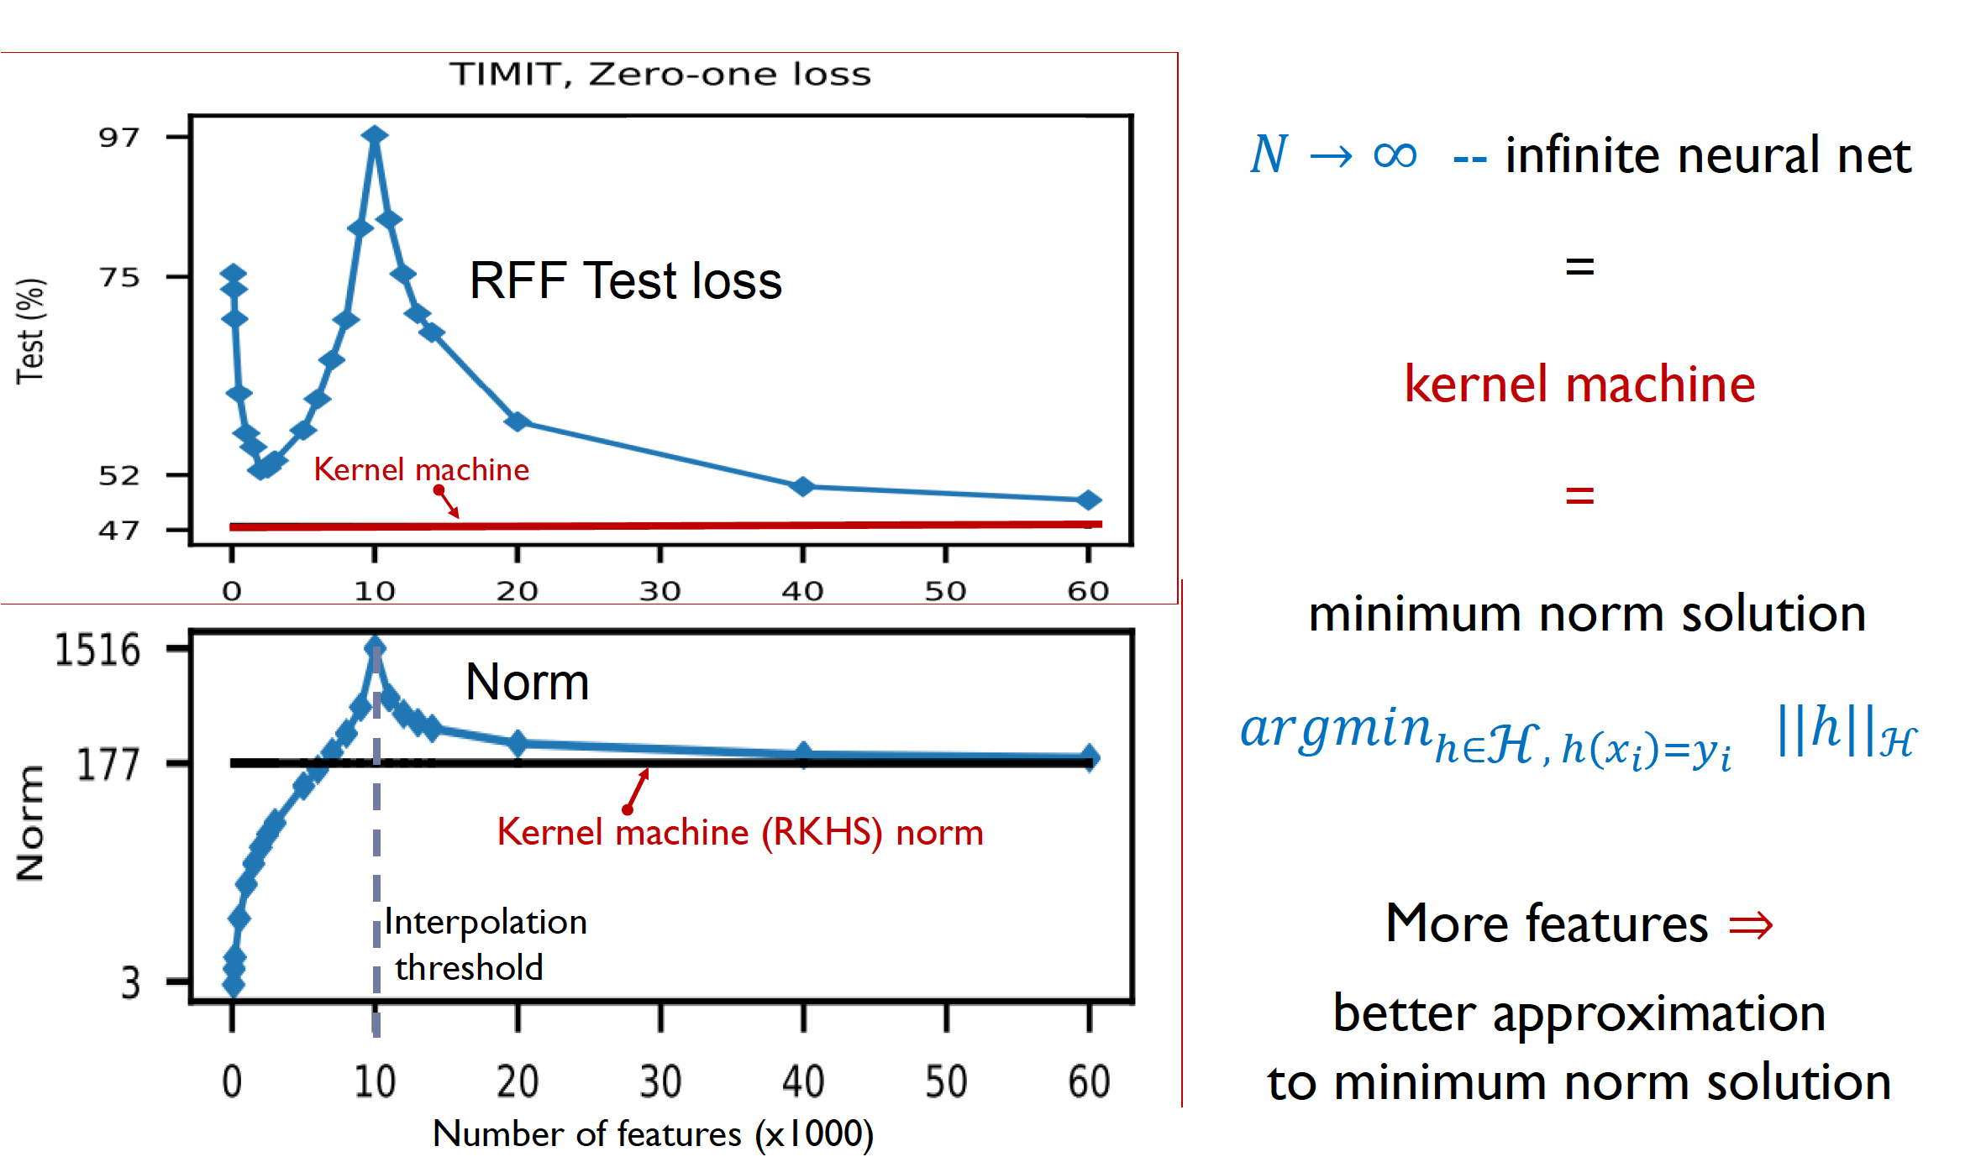
Kernel Methods

Slide 29
Richer classes have better fitting fns
For the classes that we consider, there is no guarantee that the most regular, smallest norm predictor consistent with training data is contained in the class H with features for any finite N
But increasing N allows us to construct progressively better approximations to that smallest norm function
Thus highly parameterized function classes have more members where you can choose smooth solutions that fit the data
Rich class + better inductive bias = better generalization

Slide 30
Other Ways to Increase Smoothness
Explicit: Minimal functional norm solutions
Implicit: SGD minimization
Averaging: (boosting, bagging)

Slide 31
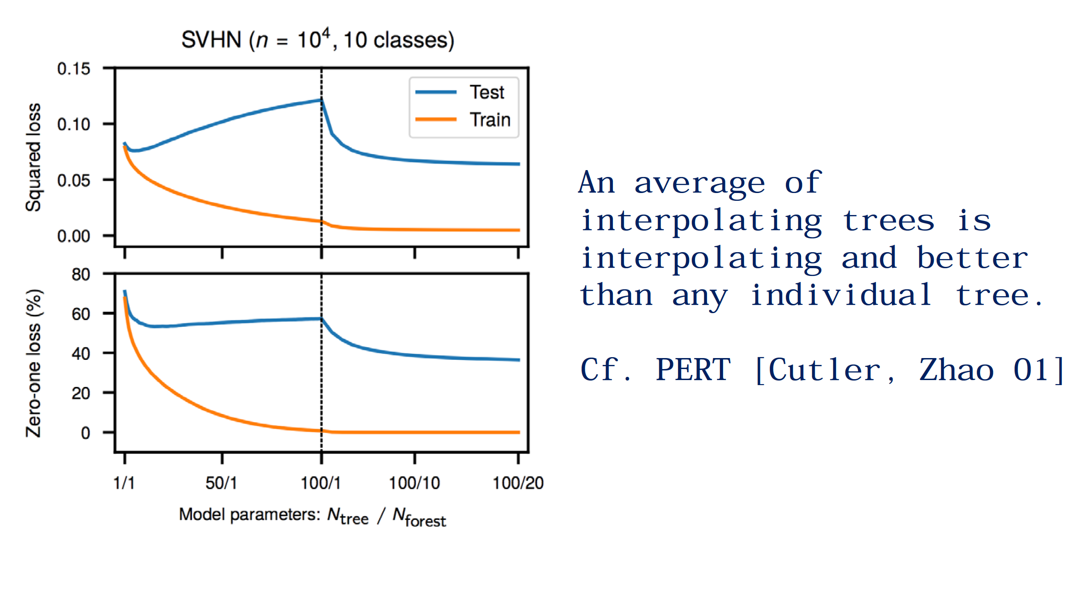
Non-neural Network Methods: Trees

Slide 32
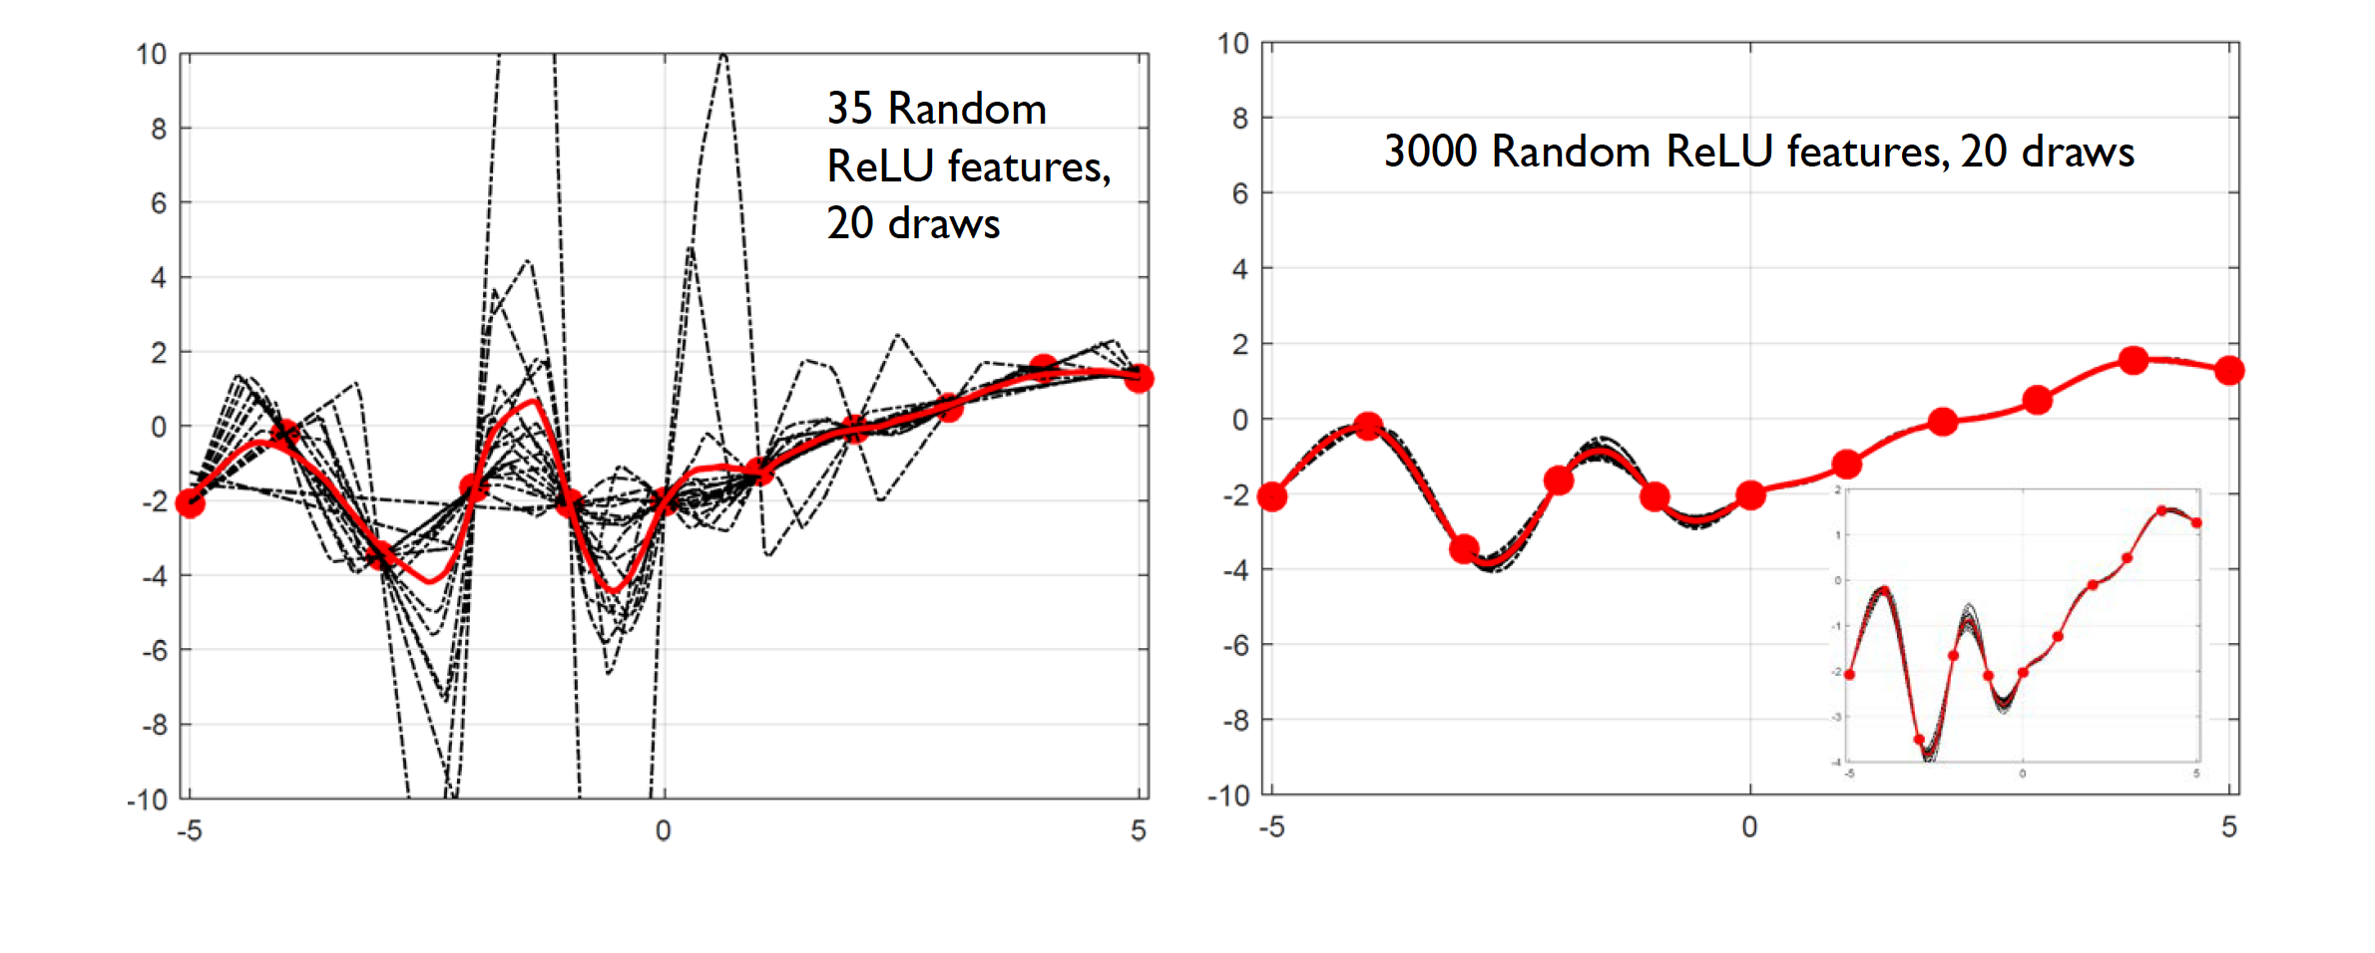
Averaging
Bagging
Boosting

Slide 33
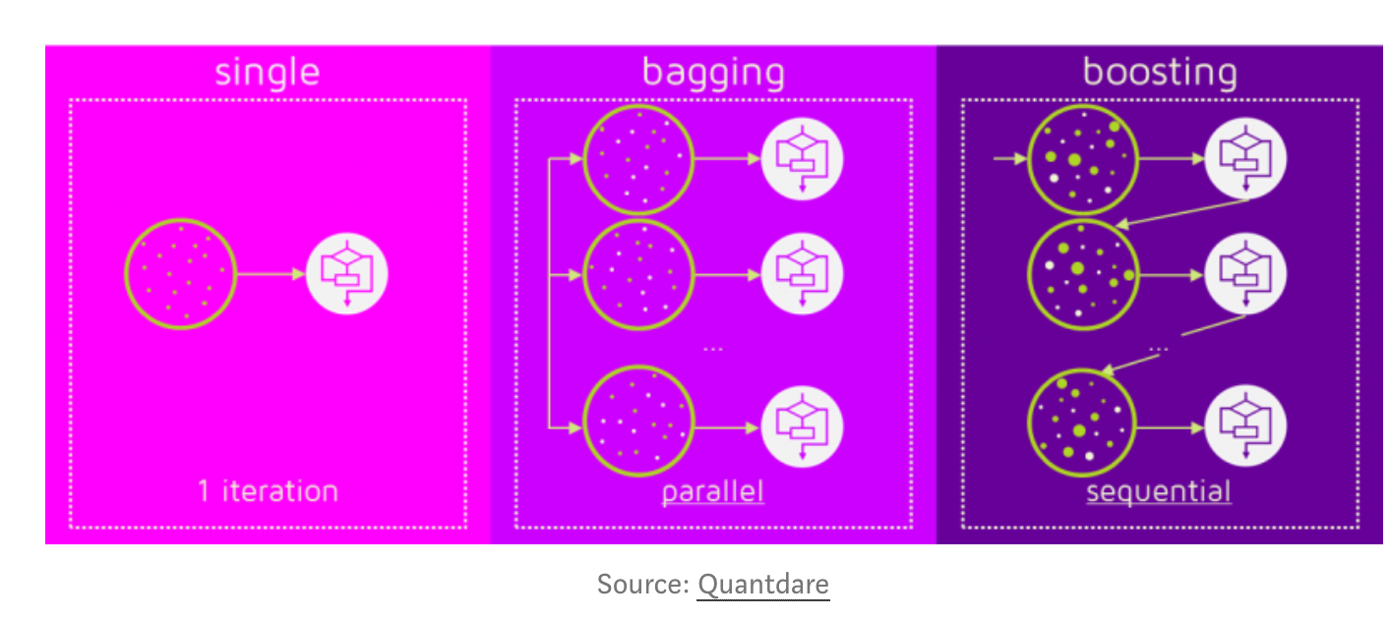
Bagging, Boosting

Slide 34
New Notion of Complexity that’s “norm-based”
Neyshabur. et al. ICLR 2019 define a new notion of complexity that increases with the number of hidden units in a restricted setting (2-layer Rel U Network)
The idea is that with a low-norm initialization hidden units only step away from the initialization by a limited amount
Tdistance Frobenius norm, measured w.r.t. initialization ||Uk − U₀k ||_{F} decreases with width of hidden layer h

Slide 35
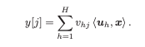
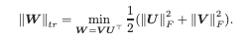
An analogy to matrix factorization
Consider a neural network with a single hidden layer consisting of linear activations
y=Wx where W = UV^{T}
Limiting the number of hidden units corresponds to a low rank factorization (zeros in columns of V)
However, recently there has been a lot of success in low norm factorizations
Low Frobenius norm:

Slide 36
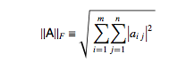
Frobenius norm of a matrix
L2 norm of all matrix entries, corresponds to “volume of matrix”

Slide 37
Low rank vs Low norm
Unlike the rank, the trace-norm (as well as other factorization norms) is convex, and leads to tractable learning problems
In fact, even if learning is done by a local search over weights of the network, if the dimensionality is high enough and the norm is regularized, we can ensure convergence to a global minima [Burer, Choi 2006]
This is in stark contrast to the dimensionality-constrained low-rank situation, where the limiting factor is the number of hidden units, and local minima are abundant [Sreebo, Jakkola, 2003]

Slide 38
Sensible Inductive Bias?
A. low-trace norm model corresponds to a realistic factor model with many factors of limited overall influence
What situations is this realistic in?
The norm of the factorization may be a better inductive bias than the number of weights
Perhaps learning is succeeding because there is a good representation with small overall norm, and the optimization is implicitly biasing us toward low-norm models

Slide 39
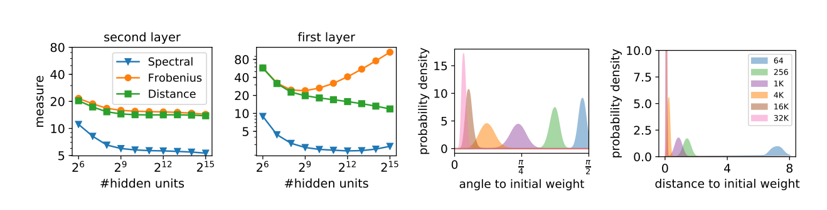
Complexity decreases with increasing hidden units
RELU network trained on CIFAR 10
[Neyshambur 2019]
It can be proven in certain cases (like matrix factorization) that SGD converges to the
lowest norm solution

Slide 40
Gradient Descent itself a regularization?
[Hardt et. Al. 2016] Any model trained with stochastic gradient method in a reasonable amount of time attains small generalization error
A randomized algorithm A is uniformly stable if for all data sets differing in only one element, the learned models produce nearly the same predictions
Stochastic gradient descent is uniformly stable
Results rest on an important theorem that uniform stability implies generalization in expectation [O. Bousquet and A. Elisseeff. 2002 Stability and generalization]

Slide 41
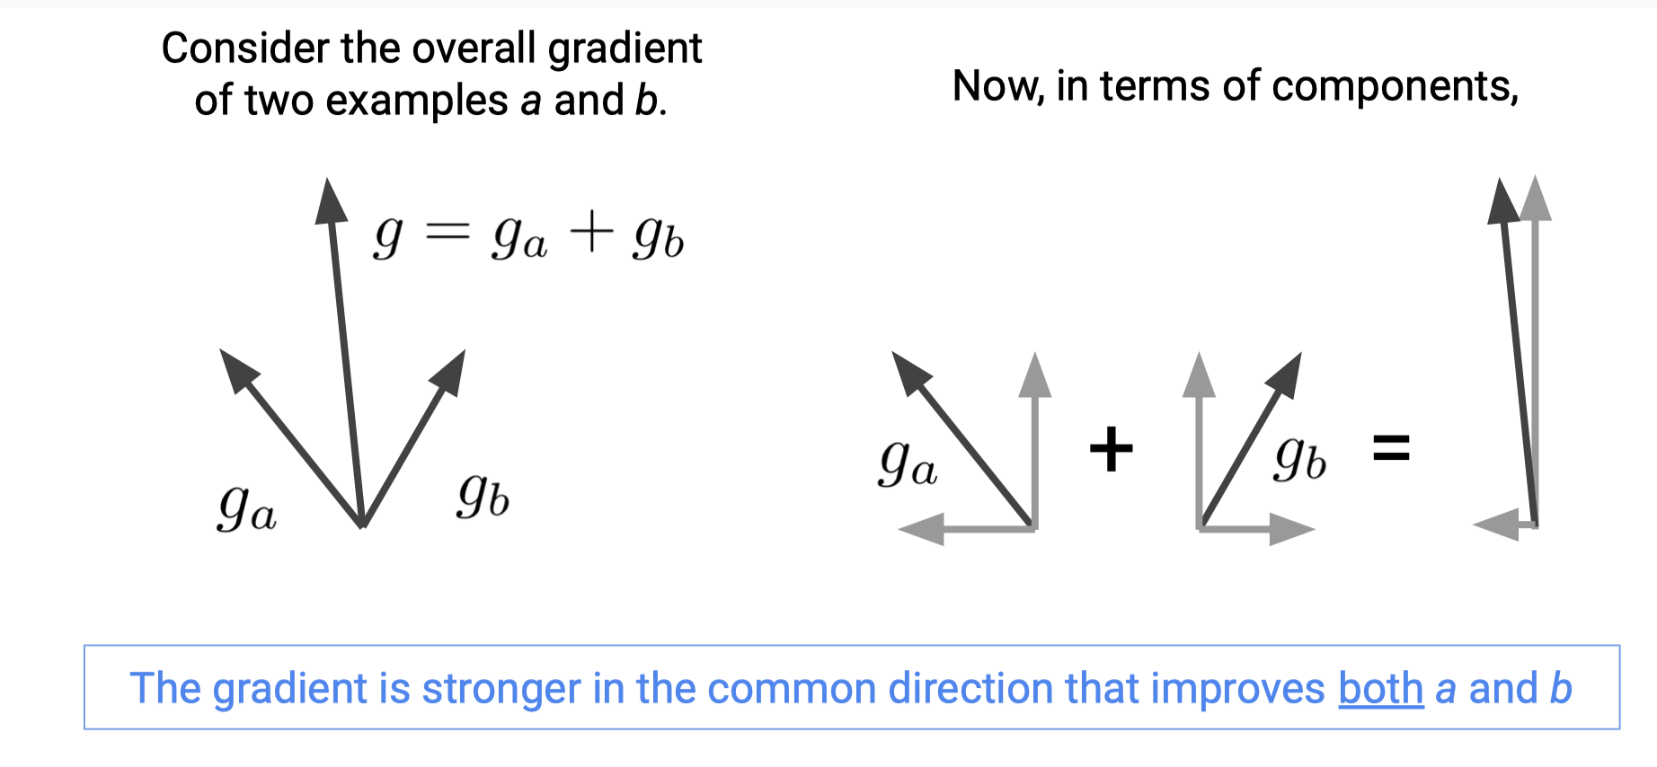
Gradients are Coherent

Slide 42
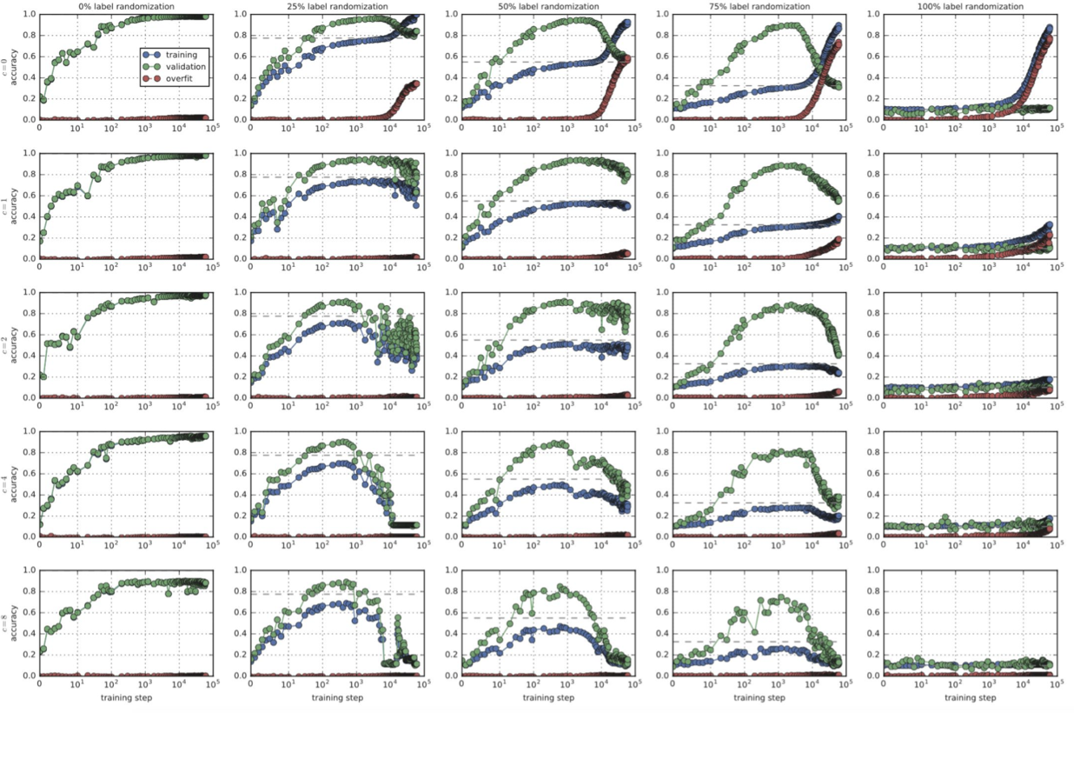
Suppressing weak gradients

Slide 43

SGD is uniformly stable for a ”reasonable” number of steps
Proof idea: analyze the output of the algorithm on two data sets that differ in precisely one point. Note that if the loss function is L-Lipschitz for every example z.
Halving the step size roughly halves the generalization error
This behavior is fairly consistent for both generalization error defined with respect to classification accuracy and cross entropy. [Hardt et al. 2016]

Slide 44
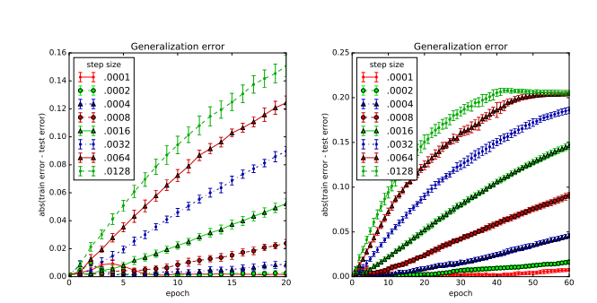
Step-size vs generalization error

Slide 45
Infinite sized norm-regularized networks?
Global weight decay, i.e. adding a regularization term that penalizes the sum of squares of all weights in the network
Weight decay can often improves generalization but it also improves stability! [Krogh et al. NIPS 1992]

Slide 46
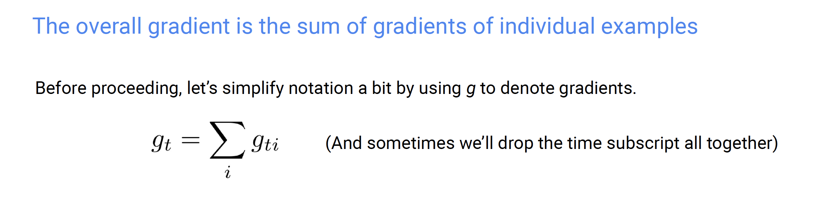

Important Property of SGD

Slide 47
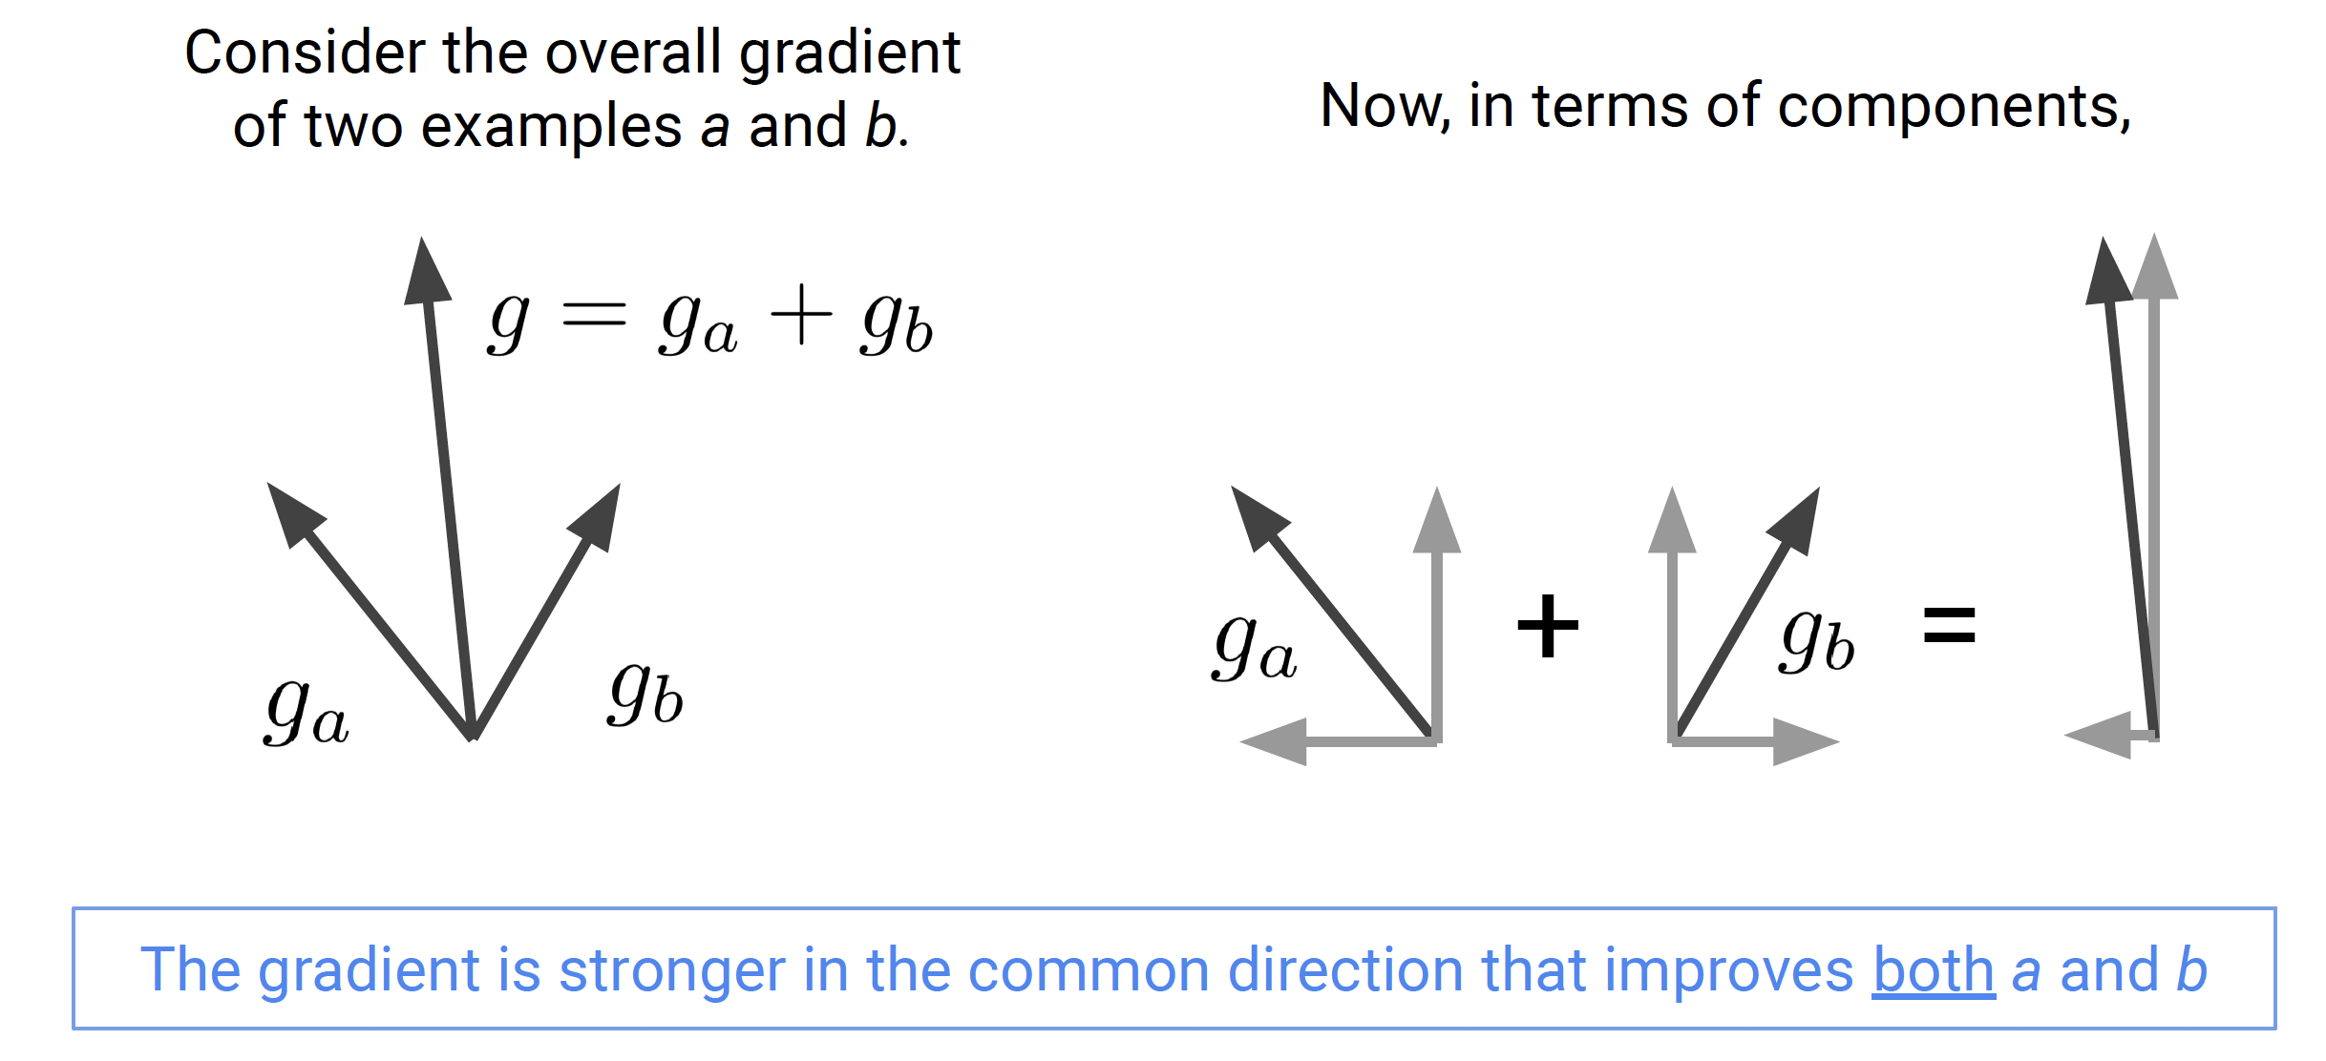
Thought Experiment

Slide 48
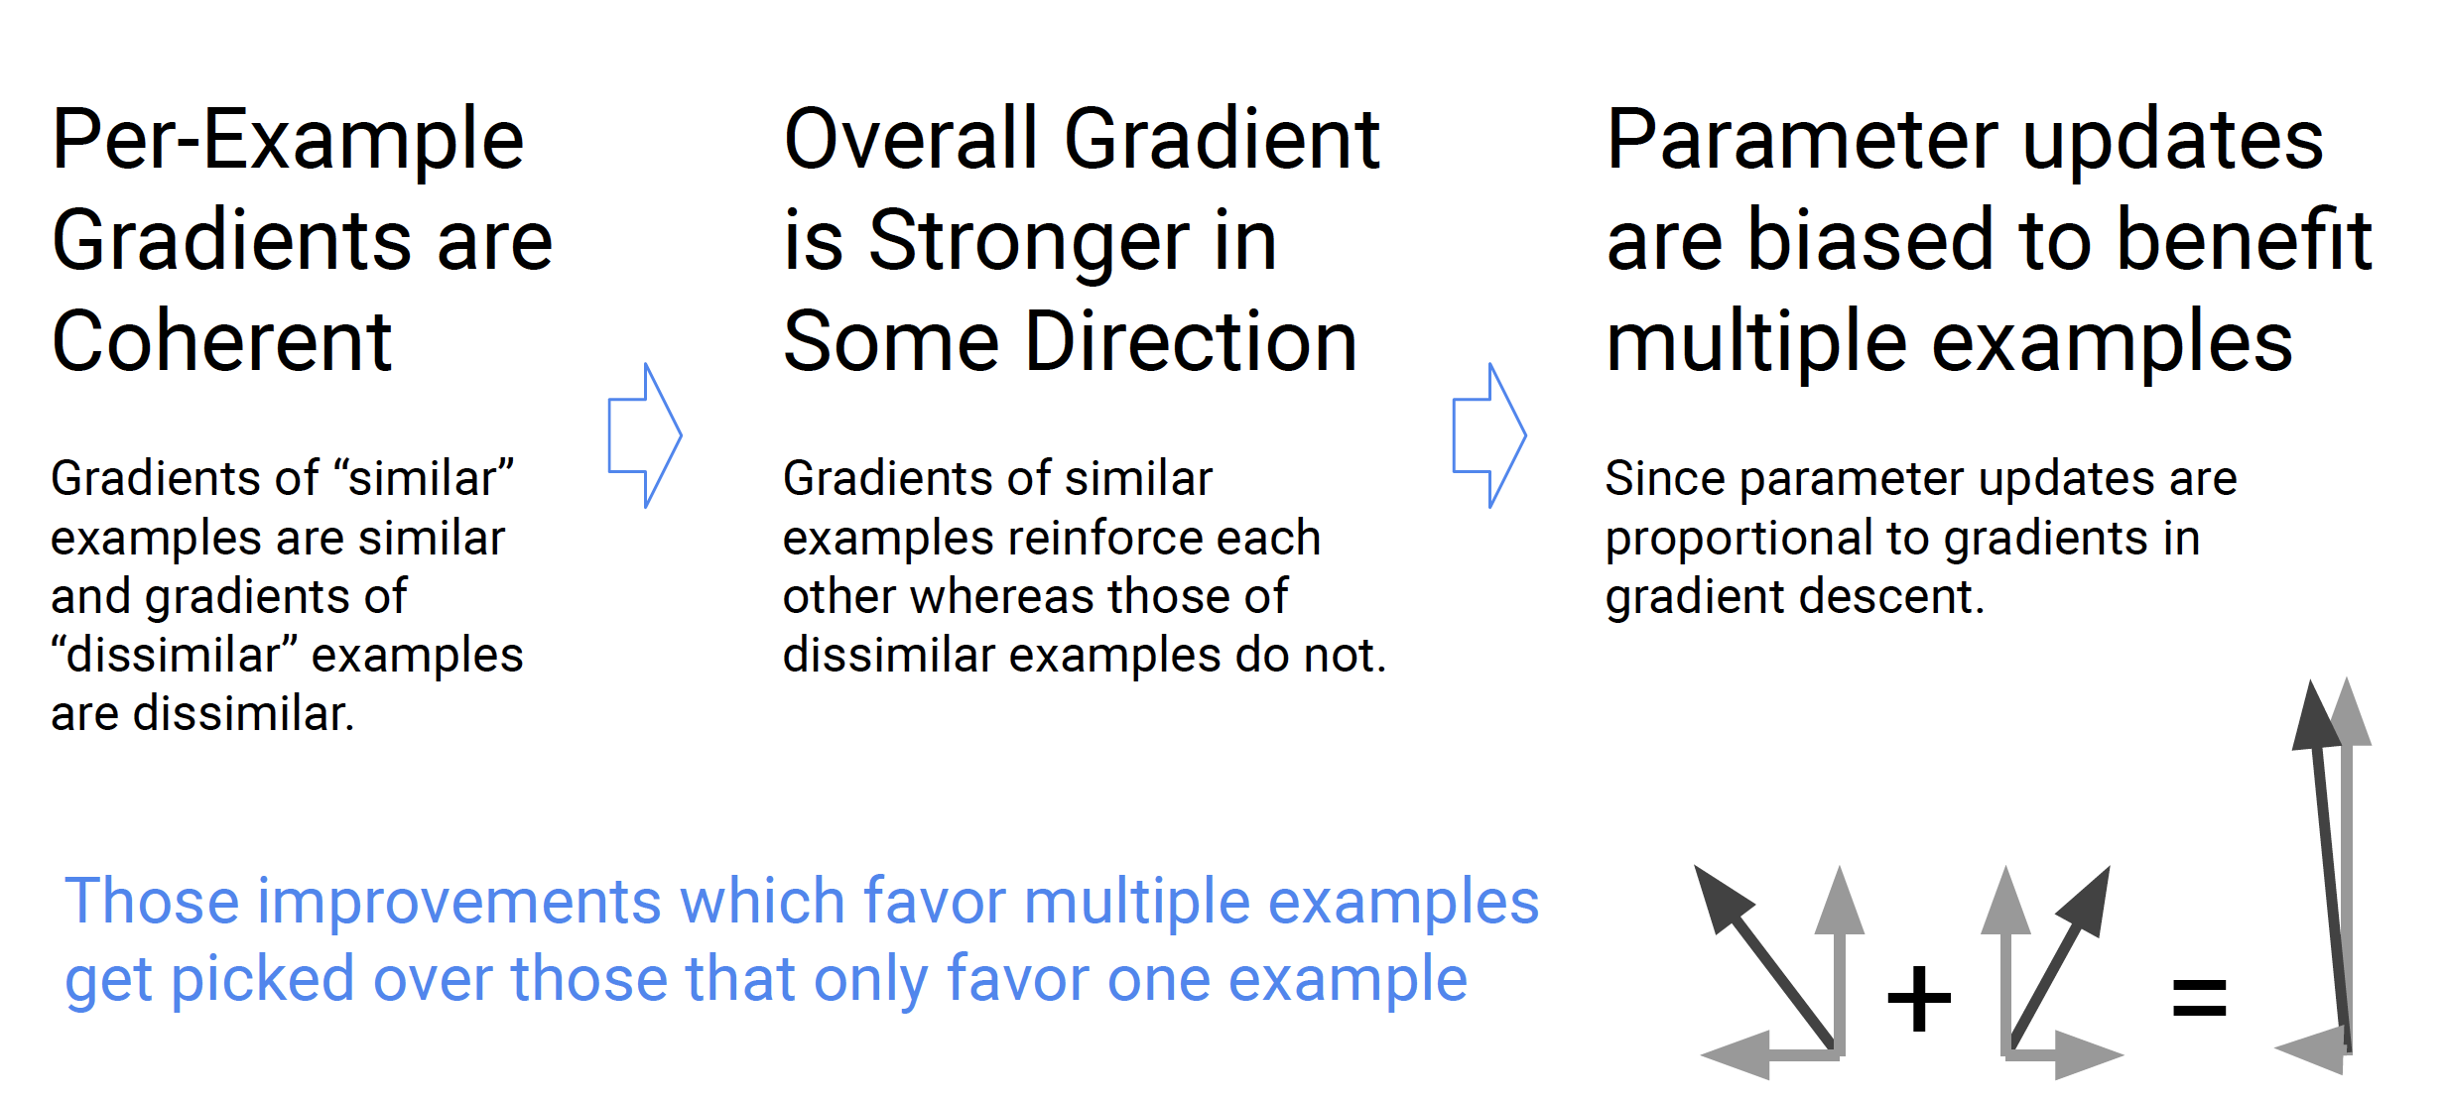
Gradients Stronger in Common Directions

Slide 49
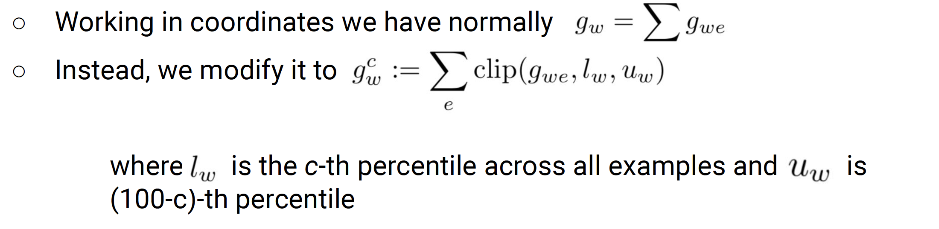
Clipping Gradients

Slide 50
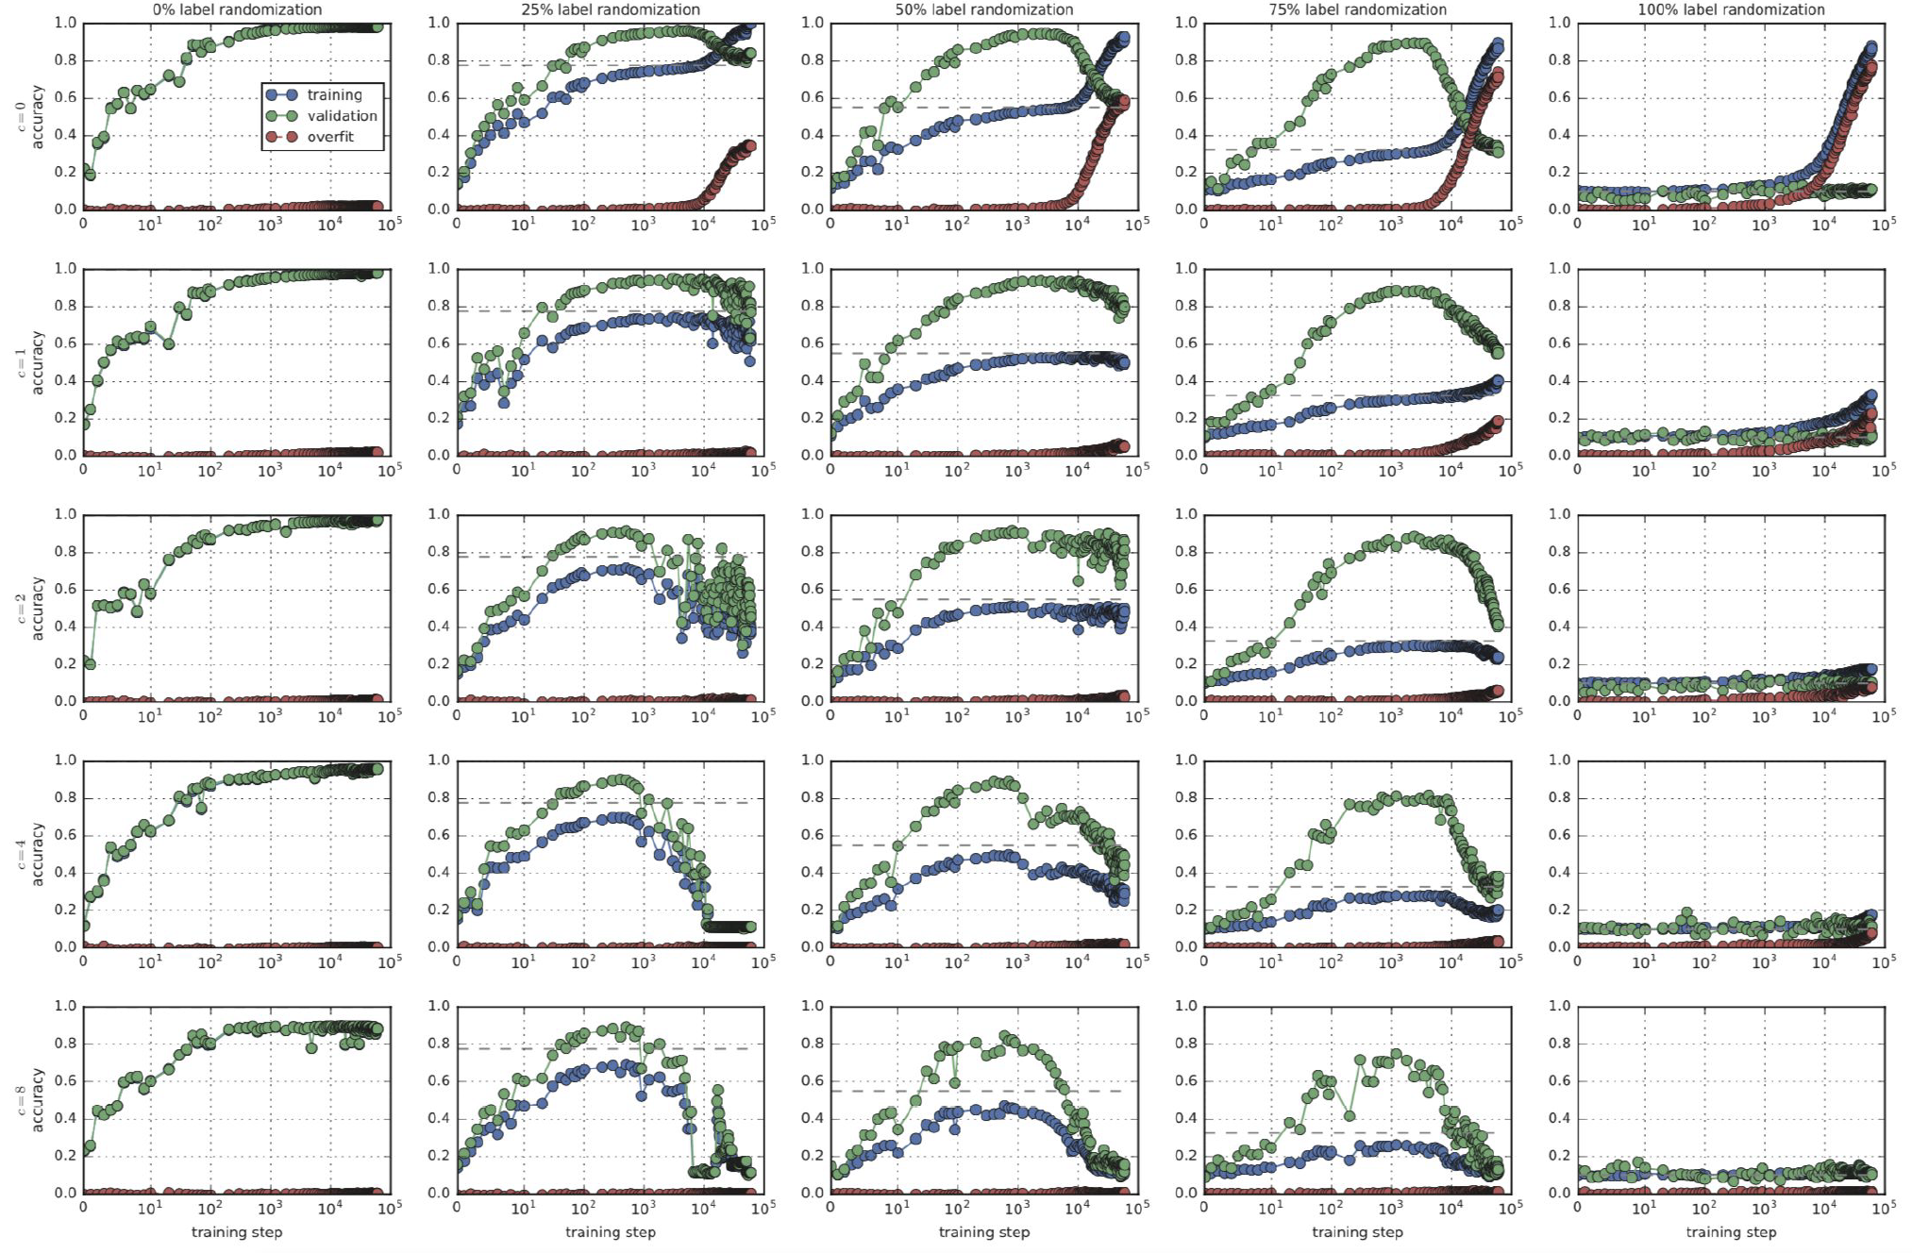
Reduces Overfitting

Slide 51
Further reading
Belkin, et al. 2019 PNAS Reconciling Modern Machine-Learning Practice and The Classical Bias-Variance Tradeoff
Understanding Deep Learning requires rethinking generalization, Zhang et al ICLR 2017 https://arxiv.org/pdf/1611.03530.pdf
A closer look at memorization in deep networks [Arpit et al 2017] https://arxiv.org/pdf/1706.05394.pdf
In search of the real inductive bias: on the role of implicit regularization in deep learning [Neyshabur et al, 2015] https://arxiv.org/pdf/1412.6614.pdf
The role of over-parametrization in generalization of neural networks [Neyshabur et al, 2019] https://arxiv.org/pdf/1805.12076.pdf
Train faster, generalize better: stability of stochastic gradient descent [Hardt et al, 2016] https://arxiv.org/pdf/1509.01240.pdf
Stability and generalization [Bousquet and A. Elisseeff 2002] https://www.academia.edu/13743279/Stability_and_generalization
Rademacher complexity: http://www.cs.cmu.edu/~ninamf/ML11/lect1117.pdf
Chatterjee S. ICLR 2020 Coherent Gradients: An approach to understanding generalization in gradient descent-based optimization https://arxiv.org/abs/2002.10657

